Slide 1
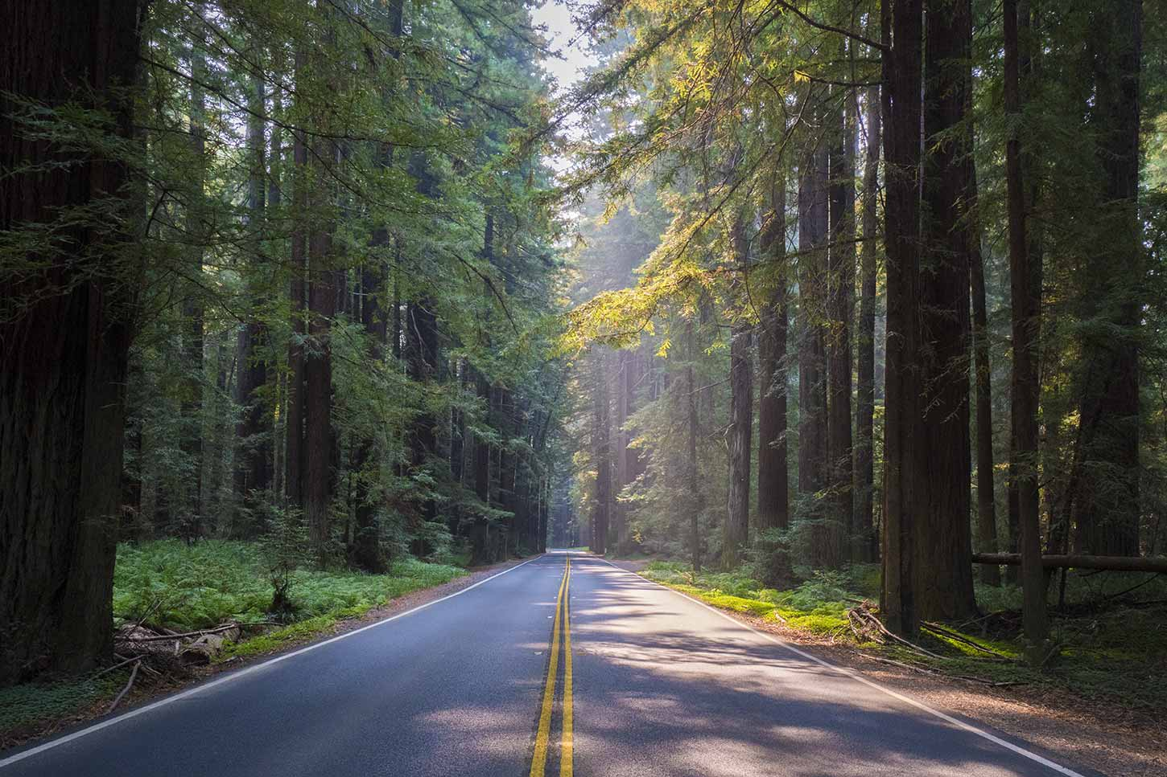
Local Roadway Safety Plan & Vision Zero
Local Road Safety/Action Plan Update
Stakeholder Meeting
March 29, 2023
Public Workshop #5 - Virtual
June 27, 2024

Slide 2
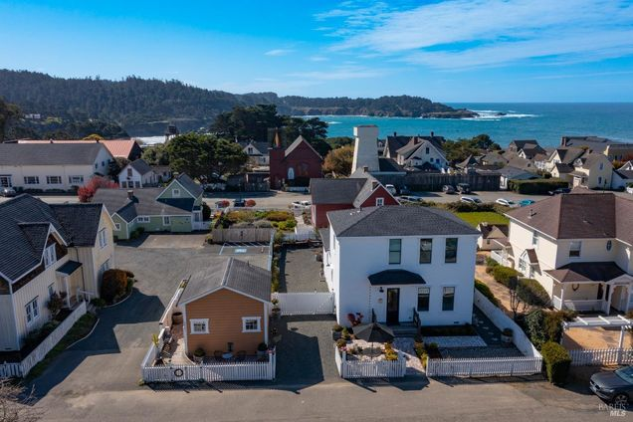
Agenda
What is a Local Road Safety/Action Plan (LRS/AP)?
Goals & Process of LRS/AP
Community Outreach
Collision Analysis, Countermeasures & Safety Projects
Discussion/Questions
Next Steps

Slide 3
What is a Local Road Safety/Action Plan (LRS/AP)?
The Local Roadway Safety/Action Plan (LRSP/AP) is an updated iteration of the 2022 LRSP, with the goal of improving safety within the county and bring the reports in line with Safe Streets and Roads for All (SS4A) criteria.
It offers thorough guidelines, including the integration of data from 2020-2022, to proactively address safety needs.
The plan is adaptable and subject to regular evaluation and updates to ensure alignment with evolving trends, community needs, and priorities.
It combines current planning initiatives with fresh data analysis, covering collision data from 2015 to 2022.
This revision will facilitate grant applications, including future opportunities such as the SS4A implementation grant, to secure funding for safety projects.
It includes updated analyses, countermeasures, and project selection criteria.
Updated monitoring and implementation guidelines have been introduced to guarantee efficiency and accountability.

Slide 4
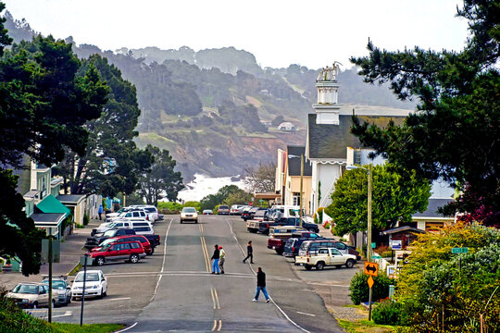
Goals of LRS/AP
Goals:
To reduce fatalities and severe injuries on county and city roads and intersections attributed to traffic collisions.
Systematically identify and analyze roadway safety problems and recommend improvements with improved project selection criteria.
Improve the safety of all road users by using proven and effective countermeasures
To prepare an eligible document for SS4A Federal Grant Program and Highway Safety Improvement Program (HSIP)

Slide 5
LRS/AP Process
Stakeholder Input
(April 11th, 2024)
Public Workshop #1 - Virtual
(April 25th, 2024)
Data Collection
(3 years – 2020-2022)
Collision Trend Analysis
Identification of High-Risk Network
Identify Emphasis Areas
Community Input
(May 20th, May 21st, May 23rd
In-Person/Virtual Public Workshops)
All injury collisions
Using Caltrans Methodology
Updated LRS/AP Reports
Cost-Estimates
and BCR
Develop Safety Projects
Develop Countermeasures Toolbox
Present project, share data, receive feedback and input, and present recommendations and projects
Public Workshop #5 - Virtual
(June 27th, 2024)
Stakeholder Input
(June 27th, 2024)
Stakeholder Input
(May 16th, 2024)

Slide 6
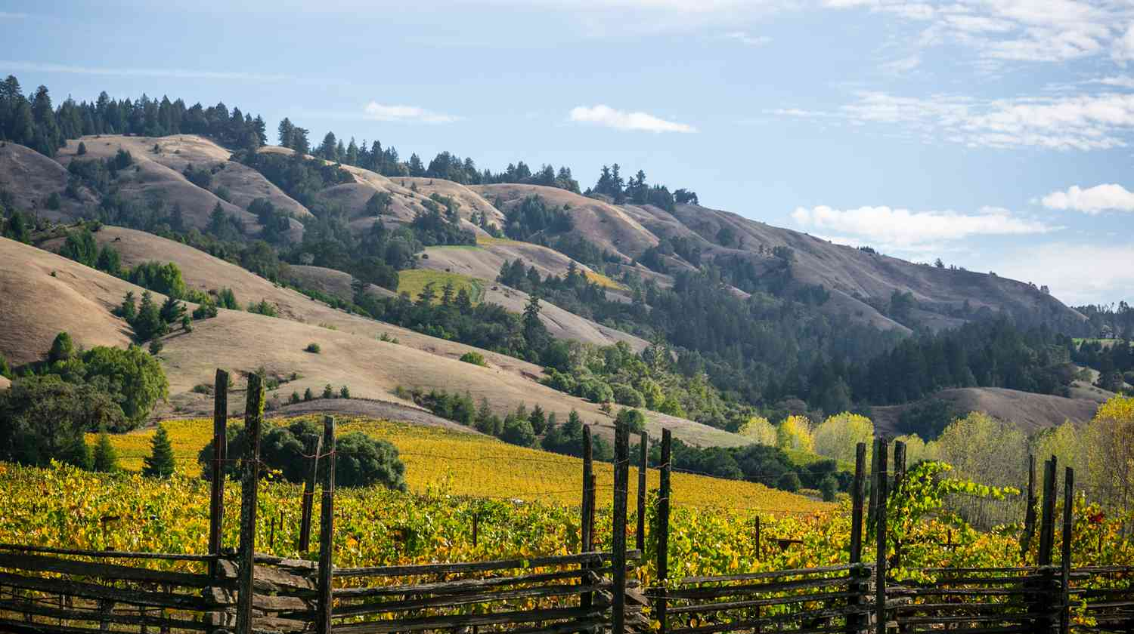
Community Outreach

Slide 7
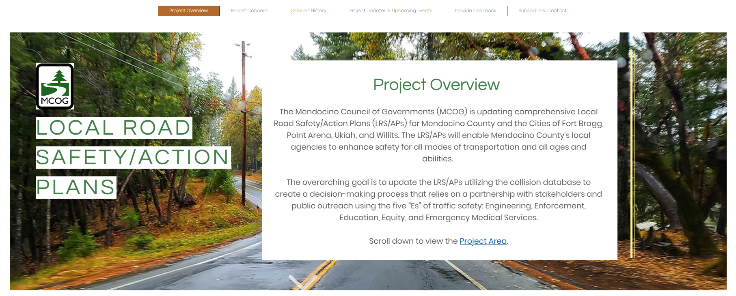
Project Webpage
https://www.mendoroadsafetyplan.com/

Slide 8
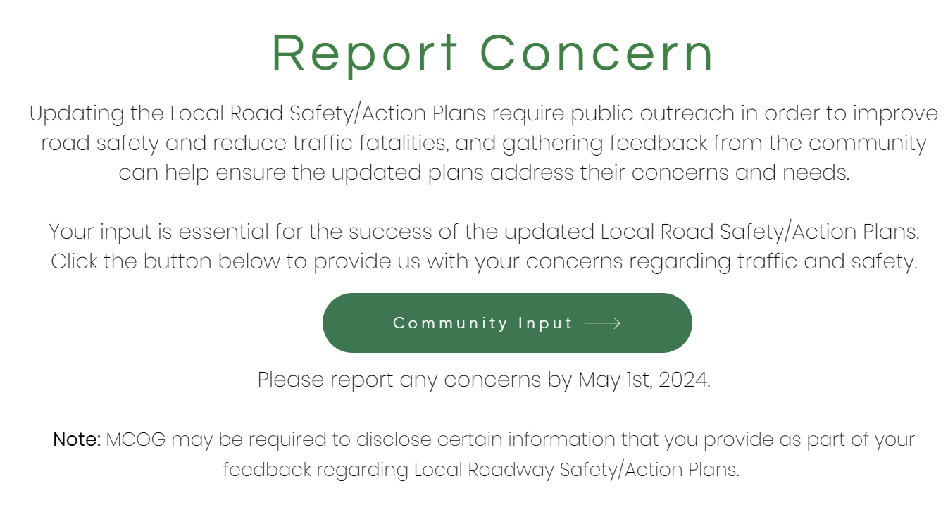
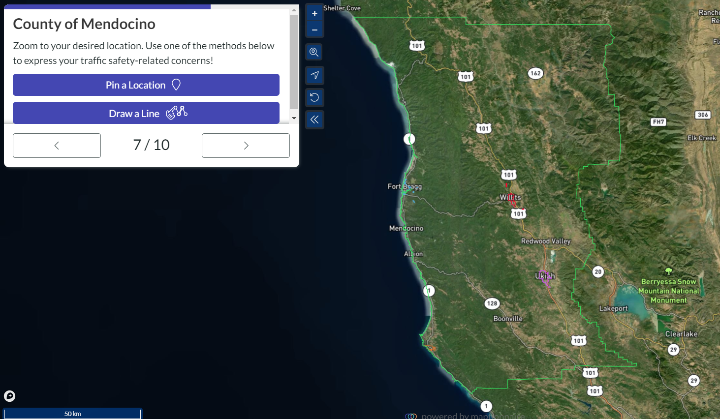
Interactive Map Input component
CLICK HERE!

Slide 9
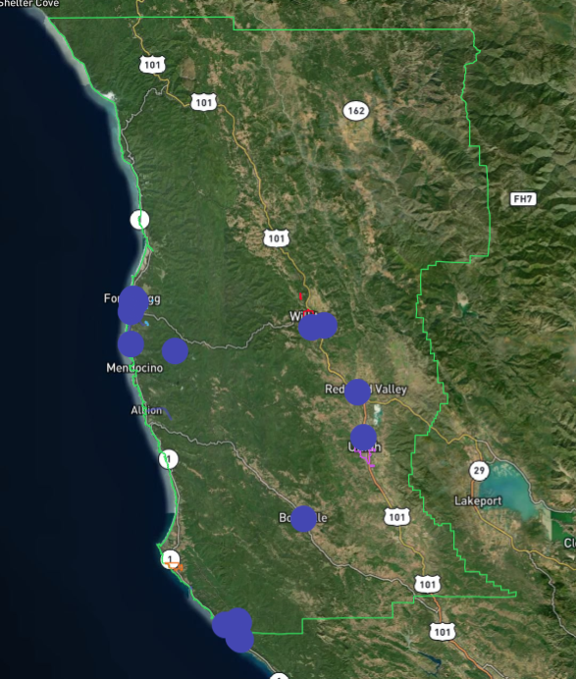
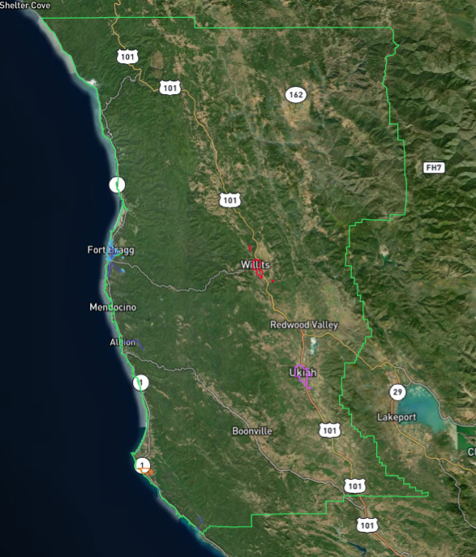
Map Input Comments
41 responses
Speeding and Pedestrian Safety were the most commented concerns

Slide 10
Map Input Comments
Traffic Concerns
Corridors with traffic concerns
Most commented concern
Most commented corridor
A total of 41 unique comments were received through the map input platform
13 residents were concerned about safety due to speeding:
13 residents were concerned about pedestrian safety
Additional concerns related to intersection safety, school safety, pavement condition, limited visibility and bicycle safety
Corridors with the most comments:
Highway 1 (Fort Bragg)
Albion Ridge Rd (County)
E Pine St (Fort Bragg)

Slide 11
Additional Community Comments
Location | Concerns | Mode
Gualala area - Old Stage Road between Ocean Ridge Drive (north intersection) and Moonrise Drive. | High vehicle speeds (far in excess of posted limits), horizontal and vertical curves, narrow vehicle lanes, storm water damage, and uneven shoulder ground surface are issues for pedestrians walking along this segment between residential areas and the heavily-used Bower Community Park. | Pedestrian & Bicycle
Gualala area – Hwy 1 between Pacific Woods Road and Ocean Drive. | As the only route for pedestrians between residential neighborhoods north of the Gualala village and sidewalk improvements intended by the SR1 Gualala Downtown Enhancements project (in design), safety of pedestrians who walk along this segment is critical | Pedestrian
Gualala area – Hwy 1 intersection with Old State Highway | The safety and function of this intersection and the effectiveness of motorist speed control | Motor Vehicle
Mendocino area - Hwy 1 at Jug Handle | Speeding at this location. | Motor Vehicle
Mendocino area - Hwy 1 at Point Cabrillo Rd/Russian Gulch State Park | Speeding at this location. | Motor Vehicle

Slide 12
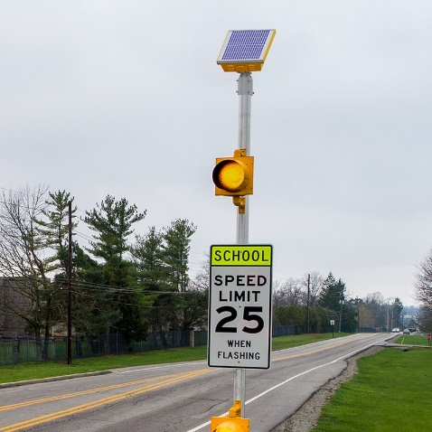
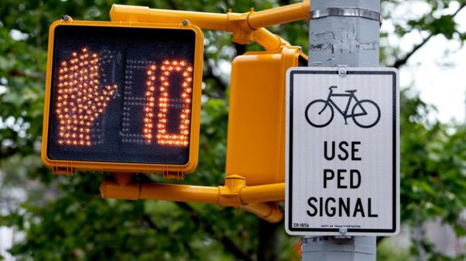
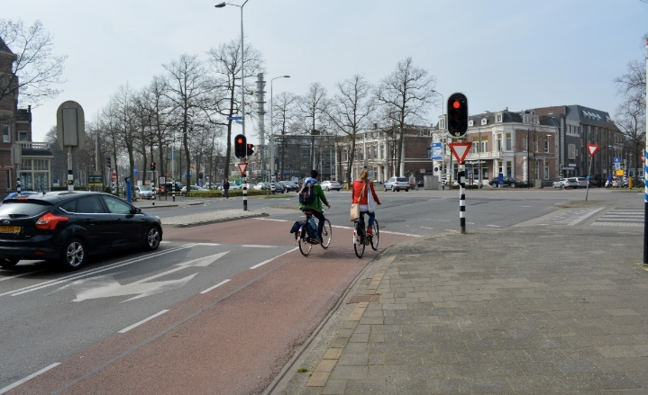
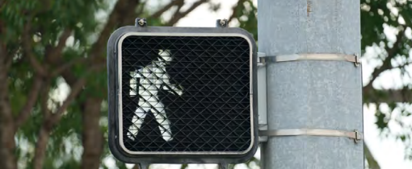
Countermeasures- Signalized Intersection Improvements
SI03- Improve signal timings (coordination, phases, red, yellow, or operation)
SI09- Install flashing beacons as advance warning (S.I)
SI18PB- Install pedestrian countdown signal heads
SI21PB- Install advance stop bar before crosswalk (Bicycle Box)
SI22PB- Modify signal phasing to implement a Leading Pedestrian Interval (LPI)

Slide 13
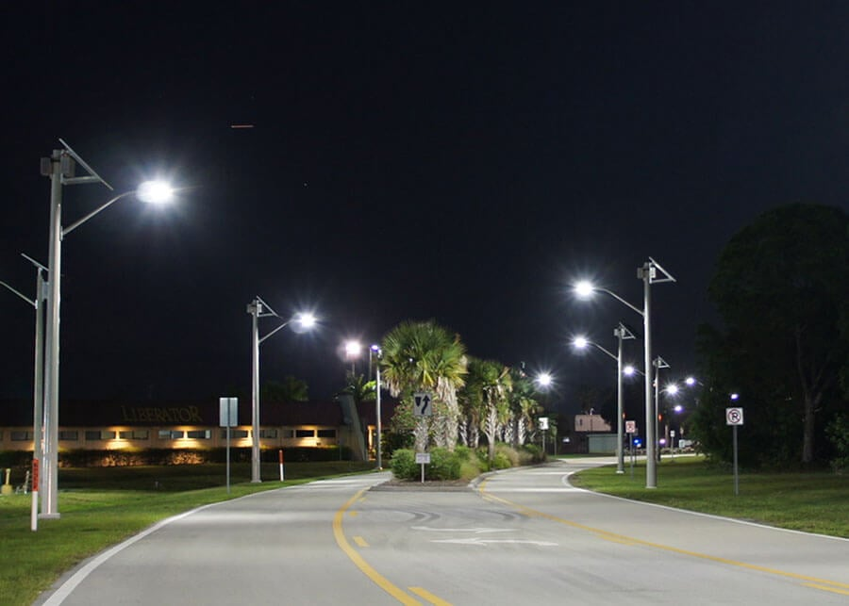
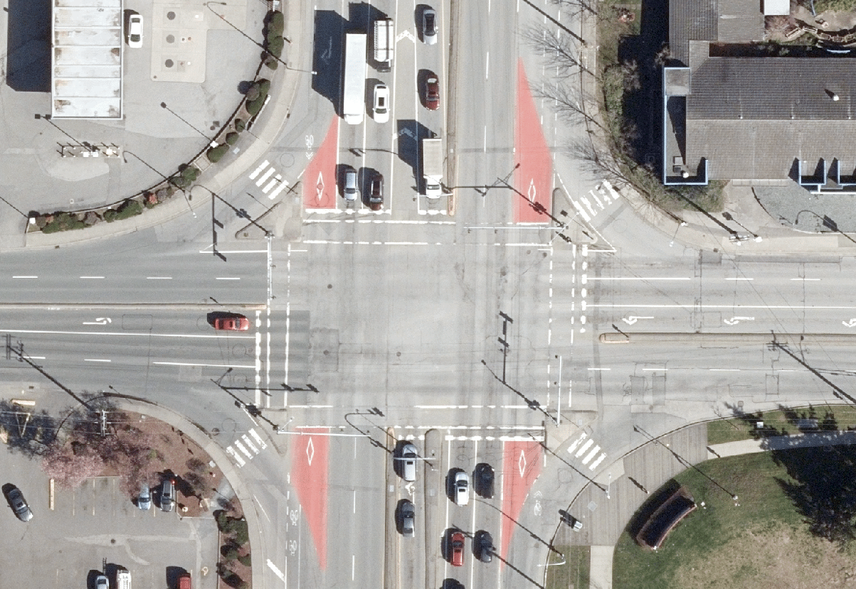
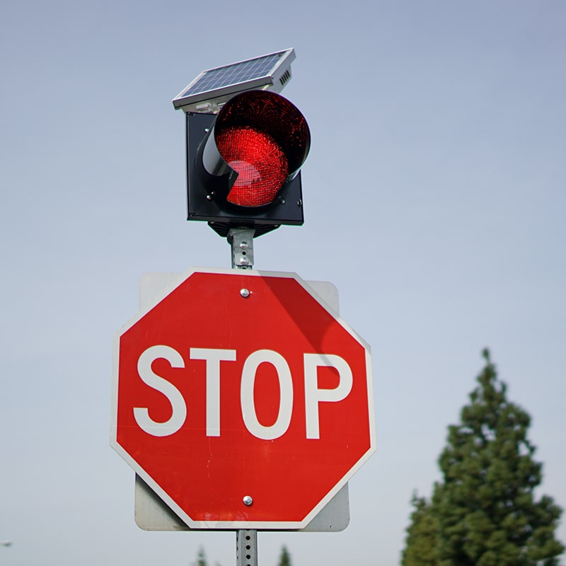
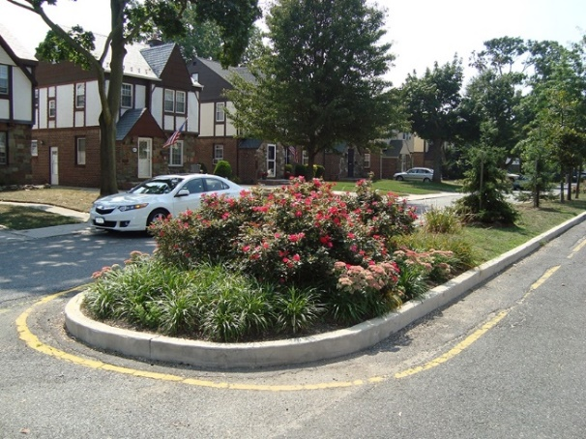
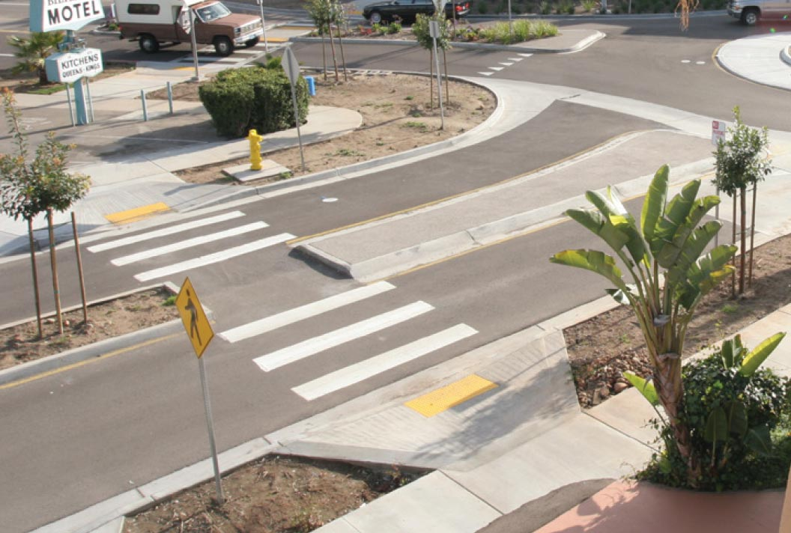
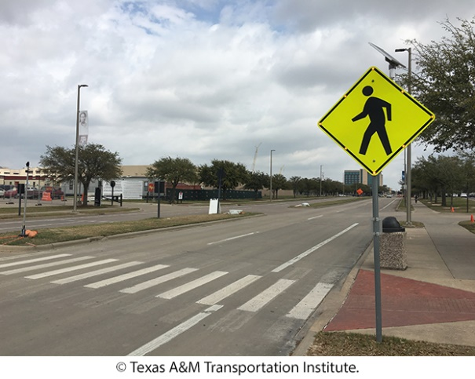
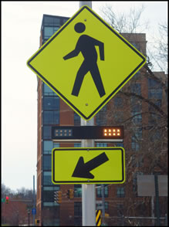
Countermeasures- Non-Signalized Intersections
NS01NT- Add intersection lighting (NS.I)
NS08- Install/upgrade larger or additional stop signs or other intersection warning/regulatory signs
NS09- Upgrade intersection pavement markings (NS.I.)
NS11- Install flashing beacons as advance warning (NS.I)
NS16- Install raised median on approaches (NS.I.)
NS21PB- Install raised medians/refuge islands (NS.I.)
NS23PB- Install/upgrade pedestrian crossing at uncontrolled locations (with enhanced safety features)
NS24PB-Install Rectangular Rapid Flashing Beacon (RRFB)

Slide 14
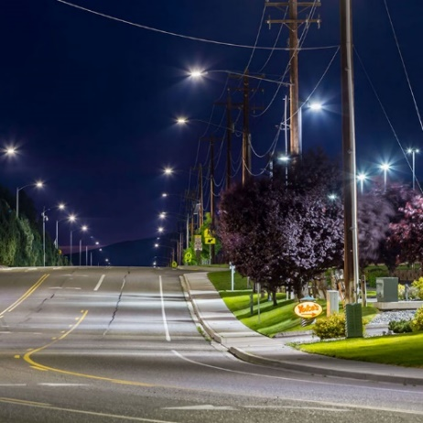
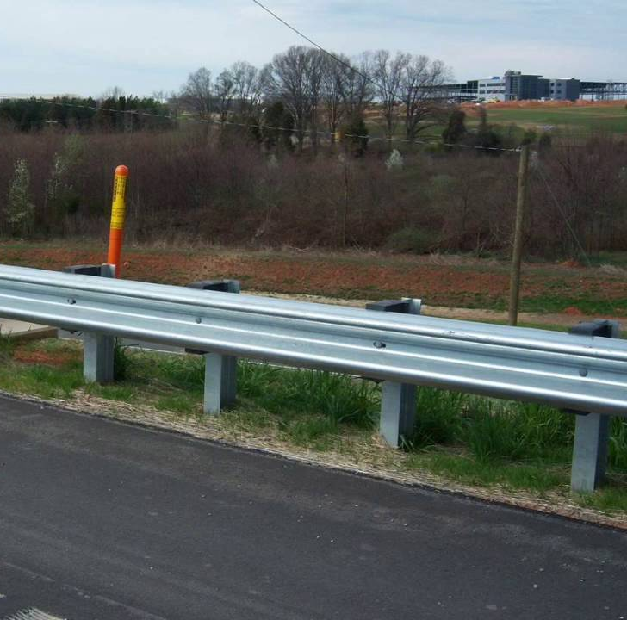
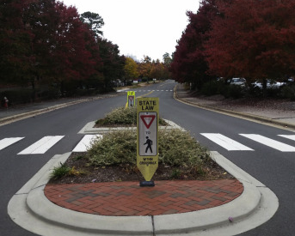
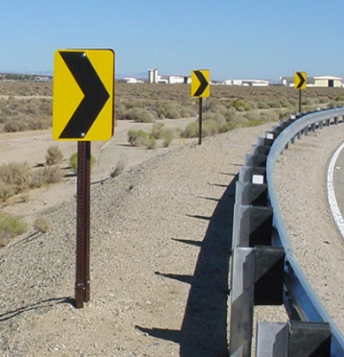
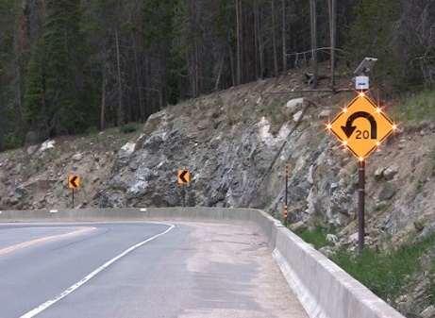
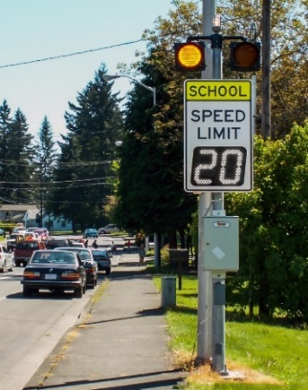
Countermeasures- Roadway Segment Improvements
R01NT- Add segment lighting
R04- Install Guardrail
R08- Install raised median
R22- Install/Upgrade signs with new fluorescent sheeting (regulatory or warning)
R23- Install chevron signs on horizontal curves
R24- Install curve advance warning signs
R25- Install curve advance warning signs (flashing beacon)
R26- Install dynamic/variable speed warning signs

Slide 15
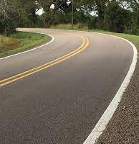
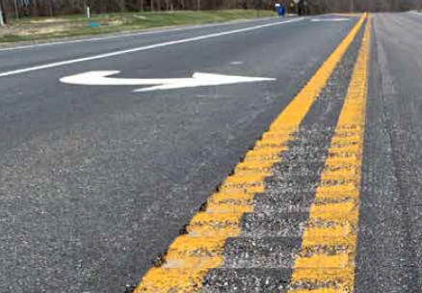
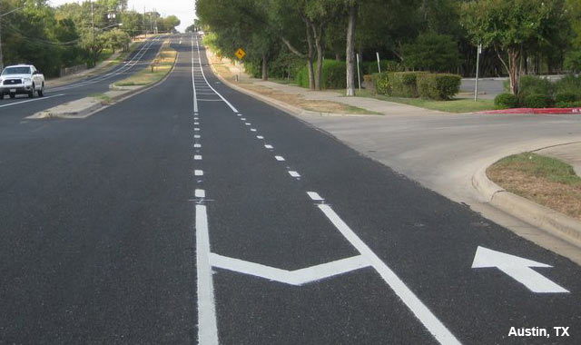
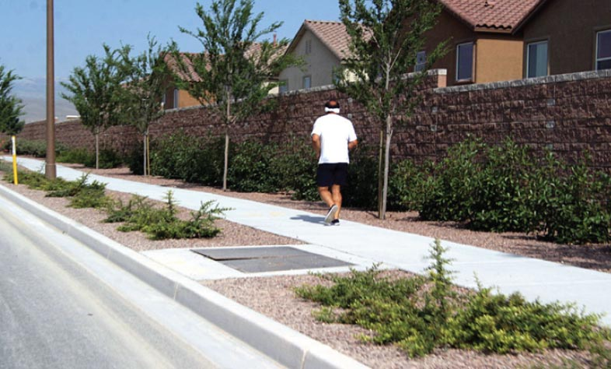
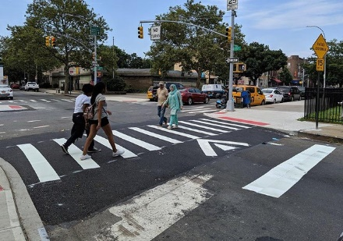
Countermeasures- Roadway Segment Improvements
R28- Install edge-lines and centerlines
R30- Install centerline rumble strips/stripes
R34PB- Install Separated Bike Lanes
R35PB- Install sidewalk/pathway (to avoid walking along roadway)
R36PB- Install/upgrade pedestrian crossing (with enhanced safety features)
R38PB- Install Rectangular Rapid Flashing Beacon (RRFB)

Slide 16
Collision Analysis
Draft Safety Projects

Slide 17
Collision Analysis Findings- Mendocino County
Mendocino County - Unincorporated (2020-2022)
Collisions by Severity (2020-2022)
Collision Severity | 2015-2019 | 2020-2022 | 2015-2022
Killed | 21 | 13 | 34
Severe Injury | 123 | 75 | 198
Visible Injury | 243 | 121 | 364
Complaint of Pain | 179 | 87 | 266
Property Damage Only (PDO) | 1,345 | N/A | 1,345
Total | 1,911 | 296 | 2,207
Note: State Route Collisions are excluded from the analysis
88 Killed & Severe Injury (KSI) collisions
Severity (2020-2022)
Violation Type (2020-2022)
Note: City of Point Arena does not have any collision history between 2020-2022
Notes:
Change PIE CHART: Nomenclature
Change to KSI

Slide 18
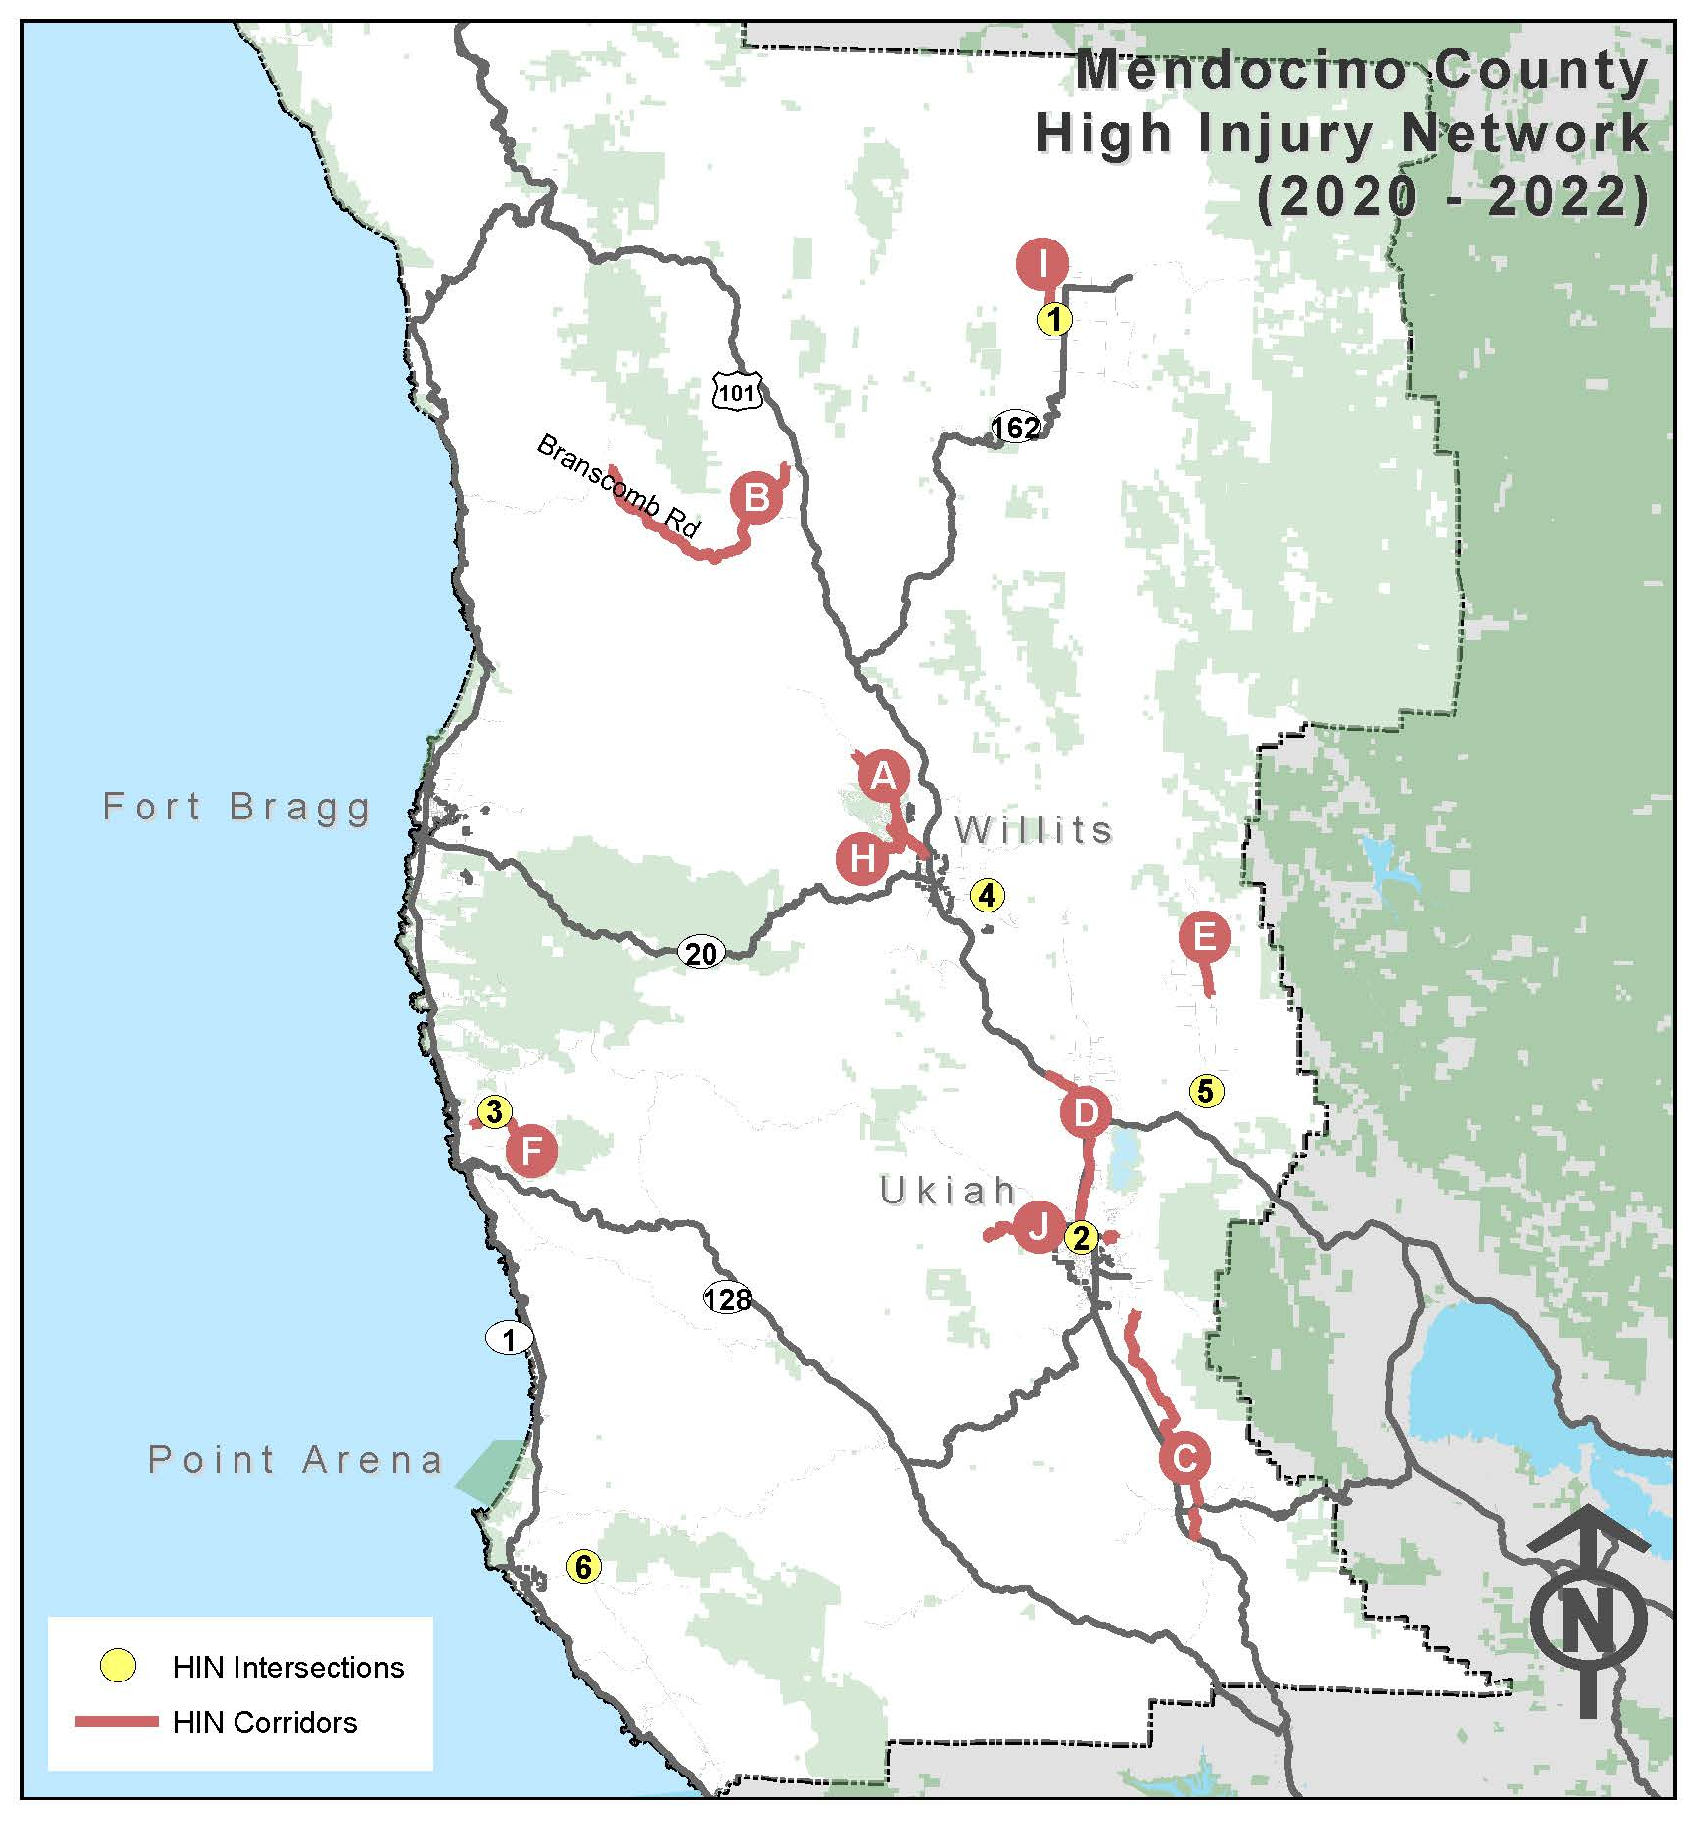
High Injury Network- Mendocino County
Mendocino County - Unincorporated (2020-2022)
ID | Intersections | Total Injury Collisions | Killed | Severe Injury | Pedestrian/Bicycle | EPDO Score
1 | Foothill Blvd & Henderson Ln | 4 | 0 | 1 | 0 | 193
2 | N State St & Empire Dr /Ford Rd | 3 | 0 | 1 | 0 | 177
3 | Albion Ridge Rd & D Rd | 1 | 0 | 1 | 0 | 165
4 | E Hill Rd & Eastside Rd | 1 | 0 | 1 | 1 | 165
5 | Eastside Potter Valley Rd & E Rd | 1 | 0 | 1 | 0 | 165
6 | Riverside Dr/Eureka Hill Rd & Buckridge Rd | 1 | 0 | 1 | 0 | 165
ID | Corridors | Total Injury Collisions | Killed | Severe Injury | Pedestrian/Bicycle | Length (miles) | EPDO Score
A | Sherwood Rd: Poppy Dr to Willits City limits | 15 | 3 | 4 | 0 | 3.8 | 1228
B | Branscomb Rd: Bauer Rd to Wilderness Lodge Rd | 13 | 0 | 4 | 0 | 14.6 | 749
C | Old River Rd: Hwy 101 to Ruddick Cunningham Rd | 8 | 2 | 2 | 0 | 12.7 | 704
D | N State St: Hwy 101 to Orr Springs Rd | 26 | 0 | 3 | 0 | 7.8 | 678
E | Eel River Rd: Gibson Ln to Main St | 4 | 1 | 3 | 0 | 1.0 | 660
F | Albion Ridge Rd: Hwy 1 to Middle Ridge Rd | 4 | 1 | 1 | 0 | 4.2 | 347
G | Vichy Springs Rd: Oak Manor Dr to Redmeyer Rd | 3 | 0 | 2 | 0 | 1.0 | 341
H | Primrose Dr: Sherwood Rd to Clover Rd | 3 | 0 | 2 | 0 | 1.1 | 341
I | Crawford Rd: Biggar Ln to Foothill Blvd | 2 | 0 | 2 | 0 | 1.0 | 330
J | Low Gap Rd: Ukiah City limits to Pine Ridge Rd | 6 | 0 | 1 | 1 | 3.7 | 215
G
Note: Green indicates locations identified as part of High Injury Network (2015-2019)

Slide 19
Safety Projects- Mendocino County
Signalized Intersections
Location | Countermeasures
Project 1: Improve Safety at Signalized Intersections.
N State St & Empire Dr/Ford Rd | SI03 | SI09
SI03 – Improve signal timing (co-ordination, phases, red, yellow, or operation)
SI09- Install flashing beacons as advance warning (S.I.)
Non- Signalized Intersections
Location | Countermeasures
Project 2: Improve Safety at Non-Signalized Intersections.
Foothill Blvd and Henderson Ln |  | NS11
Albion Ridge Rd & D Rd | NS08
E Hill Rd & Eastside Rd | NS08 | NS11
Eastside Potter Valley Rd & E Rd | NS08
Riverside Dr/Eureka Hill Rd & Buckridge Rd | NS08
NS08 – Install/upgrade larger or additional stop signs or other intersection warning/regulatory signs
NS11- Install flashing beacons as advance warning (NS.I.)

Slide 20
Safety Projects- Mendocino County
Roadways
Location | Countermeasures
Project 3: Improve Safety at Roadway Segments.
Sherwood Rd: Poppy Dr to Willits City limits | R04
Branscomb Rd: Bauer Rd to Wilderness Lodge Rd | R04
N State St: Hwy 101 to Orr Springs Rd | R04 | R22
Eel River Rd: Gibson Ln to Main St | R04 | R22
Albion Ridge Rd: Hwy 1 to Middle Ridge Rd | R04
Vichy Springs Rd/Redmeyer Rd: Oak Manor Dr to Redmeyer Rd | R04
Primrose Dr: Sherwood Rd to Clover Rd | R04 | R22
Crawford Rd: Biggar Ln to Foothill Blvd |  | R22
Low Gap Rd: Ukiah City Limits to Pine Ridge Rd | R04 | R22
R04- Install Guardrail
R22 – Install/Upgrade signs with new fluorescent sheeting (regulatory or warning)
Location | Countermeasures
Project 4: Improve Safety at Roadway Segments
Sherwood Rd: Poppy Dr to Willits City limits | R23 |  | R25
Branscomb Rd: Bauer Rd to Wilderness Lodge Rd | R23 |  | R25
Old River Rd: Hwy 101 to Ruddick Cunningham Rd | R23 |  | R25
Vichy Springs Rd/Redmeyer Rd: Oak Manor Dr to Redmeyer Rd | R23 | R24
Primrose Dr: Sherwood Rd to Clover Rd | R23 | R24
Crawford Rd: Biggar Ln to Foothill Blvd | R23
Low Gap Rd: Ukiah City Limits to Pine Ridge Rd | R23 | R24
R23 – Install chevron signs on horizontal curves
R24- Install curve advance warning signs
R25- Install curve advance warning signs (flashing beacon)
*Ball Bank Study will be conducted to mitigate injury collisions

Slide 21
Safety Projects- Mendocino County
Roadways
Location | Counter Measures
Project 5: Improve Safety at Roadway Segments.
Sherwood Rd: Poppy to Willits City limits | R30
Branscomb Rd: Bauer Rd to Wilderness Lodge Rd | R30
Old River Rd: Redwood Hwy to Ruddick Cunningham Rd | R30
North State St: Redwood Hwy to Orr Springs Rd | R30
Eel River Rd: Gibson Ln to Main St | R30
Albion Ridge Rd: Shoreline Hwy to Middle Ridge Rd | R30
Vichy Springs Rd/Redmeyer Rd: Oak Manor Dr to Redmeyer Rd | R30
Primrose Dr: Sherwood Rd to Clover Rd | R30
Crawford Rd: Biggar Ln to Foothill Blvd | R30
R30- Install centerline rumble strips/stripes

Slide 22
Collision Analysis Findings- Fort Bragg
City of Fort Bragg (2020-2022)
Collisions by Severity (2020-2022)
Collision Severity | 2015-2019 |  |  | 2020-2022 |  |  | 2015-2022
 | City | State Routes | Total | City | State Routes | Total | Total
Killed | 0 | 1 | 1 | 1 | 0 | 1 | 2
Severe Injury | 0 | 4 | 4 | 1 | 3 | 4 | 8
Visible Injury | 10 | 13 | 23 | 9 | 10 | 19 | 42
Complaint of Pain | 16 | 34 | 50 | 12 | 20 | 32 | 82
Property Damage Only (PDO) | 280 | 190 | 470 | 135 | 84 | 219 | 689
Total | 306 | 242 | 548 | 158 | 117 | 275 | 823
Note: State Route 1 & 20 collisions are included in the analysis
5 Killed & Severe Injury (KSI) collisions
Severity (2020-2022)
Violation Type (2020-2022)
Notes:
Change PIE CHART: Nomenclature
Change to KSI

Slide 23
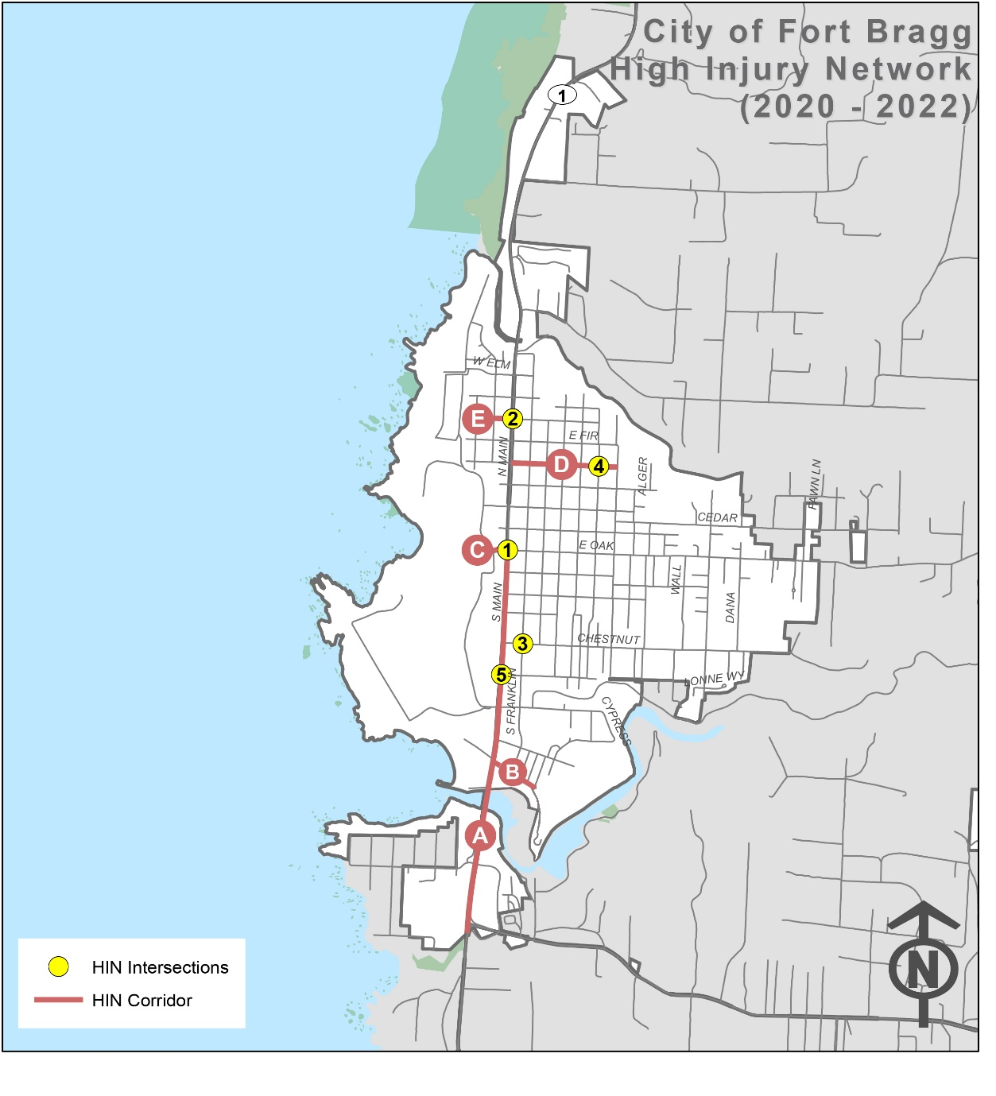
High Injury Network- Fort Bragg
City of Fort Bragg (2020-2022)
ID | Intersections | Total Injury Collisions | Killed | Severe Injury | Pedestrian/ Bicycle | EPDO Score
1 | E/W Oak St & S Main St | 7 | 0 | 1 | 4 | 206
2 | E/W Bush St & N Main St | 3 | 0 | 1 | 0 | 182
3 | E Chestnut St & S Franklin St | 2 | 0 | 1 | 0 | 171
4 | E Pine St & N Corry St | 1 | 1 | 0 | 0 | 165
5 | Walnut St & S Main St | 1 | 0 | 1 | 0 | 165
ID | Corridors | Total Injury Collisions | Killed | Severe Injury | Pedestrian/ Bicycle | Length (miles) | EPDO Score
A | S Main St: Fort Bragg City Limit to E/W Oak St | 9 | 0 | 1 | 3 | 1.0 | 233
B | N Harbor Dr: S Main St to Dock St & City limits (South) to Woodward St | 4 | 0 | 1 | 1 | 0.8 | 182
C | W Oak: N Main St to Chief Celeri Dr | 2 | 0 | 1 | 0 | 0.2 | 171
D | E Pine St: N Main St to N Harold St | 1 | 1 | 0 | 0 | 0.3 | 165
E | W Bush: N Main St to West St | 1 | 0 | 1 | 0 | 0.1 | 165
Existing Roadway System: https://www.city.fortbragg.com/departments/community-development/general-plan-zoning-information/inland-land-use-development-and-general-plan/-folder-42

Slide 24
Safety Projects-Fort Bragg
Non- Signalized Intersections
Location | Countermeasures
Project 1: Improve Safety at Non-Signalized Intersections.
E Chestnut St & S Franklin St | NS01NT | NS08
E Pine St & N Corry St | NS01NT | NS08
NS01NT – Add intersection lighting (NS.I.)
NS08 – Install/upgrade larger or additional stop signs or other intersection warning/regulatory signs
Location | Countermeasures
Project 2: Improve Pedestrian Safety at Non-Signalized Intersection.
S Lincoln St & Willow St | NS21PB | NS23PB
NS21PB – Install raised medians/refuge islands (NS.I.)
NS23PB – Install/upgrade pedestrian crossing at uncontrolled locations (with enhanced safety features)
Roadways
Location | Countermeasures
Project 3: Improve Safety at Roadway Segments.
N Harbor Dr: S Main St to Woodward St | R01NT |  | R28
E Pine St: N Main St to N Harold St | R01NT | R26 | R28
W Bush: N Main St to West St | R01NT |  | R28
Maple St: S Main St to S Harold St | R01NT | R26 | R28
Willow St : S Harold St to Wall St | R01NT | R26 | R28
Elm St: Glass Beach Dr to N Franklin St | R01NT |  | R28
W Oak St: Chief Celeri to S Main Street |  |  | R28
E Chestnut St: S Main Street to Dana St |  |  | R28
R01NT – Add segment lighting
R26 – Install dynamic/variable speed warning signs
R28 – Install edge-lines and centerlines

Slide 25
Safety Projects-Fort Bragg
Roadways
Location | Countermeasures
Project 4: Improve Pedestrian/Bicycle Safety at Roadway Segments.
N Harbor Dr: S Main St to Woodward St |  | R35PB
Maple St: S Main St to S Harold St |  | R35PB | Restripe existing bike lane
Willow St : S Harold St to Wall St |  | R35PB
W Oak Street: Chief Celeri to S Main Street | R34PB | R35PB
E Pine St: N Main St to N Harold St |  |  | Restripe existing bike lane
E Oak St: S Main St to Dana St |  |  | Restripe existing bike lane
R34PB – Install Separated Bike Lanes
R35PB – Install sidewalk/pathway (to avoid walking along roadway)
Citywide Projects
Location | Countermeasures
Project 5: Citywide Sign Inventory: This project will involve and include all the parts of the city to improve, replace, or install new signage throughout the entire city. Regulatory and warning
Citywide Sign Inventory | R22
R22 – Install/Upgrade signs with new fluorescent sheeting (regulatory or warning)

Slide 26
Safety Projects-Fort Bragg
Recommended Projects related to S Main Street/Hwy 1 (Caltrans)
Signalized Intersections
Location | Countermeasures
Project 1: Improve Safety at Signalized Intersections.
E/W Oak St & S Main St | SI03
SI03 – Improve signal timing (co-ordination, phases, red, yellow, or operation)
Location | Countermeasures
Project 2: Improve Pedestrian and Bicycle Safety at Signalized Intersections.
E/W Oak St & S Main St | SI21PB | SI22PB
SI21PB – Install advance stop bar before crosswalk (Bicycle Box)
SI22PB- Modify signal phasing to implement a Leading Pedestrian Interval (LPI)
Non-Signalized Intersections
Location | Countermeasures
Project 3: Improve Safety at Non-Signalized Intersections.
E/W Bush St & N Main St | NS01NT | NS08
NS01NT – Add intersection lighting (NS.I.)
NS08 – Install/upgrade larger or additional stop signs or other intersection warning/regulatory signs
Location | Countermeasures
Project 4: Improve Safety at Non-Signalized Intersections.
E/W Bush St & N Main St | NS09 | NS11 | NS23PB
NS09 – Upgrade intersection pavement markings (NS.I.)
NS11- Install flashing beacons as advance warning (NS.I.)
NS23PB- Install/upgrade pedestrian crossing at uncontrolled locations (with enhanced safety features)

Slide 27
Safety Projects-Fort Bragg
Recommended Projects related to S Main Street/Hwy 1 (Caltrans)
Roadways
Location | Countermeasures
Project 5: Improve Safety at Roadway Segments.
S Main St: Fort Bragg City Limits to Oak St | R22 | R26
R22 – Install/Upgrade signs with new fluorescent sheeting (regulatory or warning)
R26 – Install dynamic/variable speed warning signs
Location | Countermeasures
Project 6: Improve Safety at Roadway Segments.
S Main St: Fort Bragg City Limits to Oak St | R36PB | R38PB
R36PB – Install/upgrade pedestrian crossing (with enhanced safety features)
R38PB – Install Rectangular Rapid Flashing Beacon (RRFB)

Slide 28
Collision Analysis Findings- Ukiah
Collisions by Severity (2020-2022)
City of Ukiah (2020-2022)
Collision Severity | 2015-2019 | 2020-2022 | 2015-2022
Killed | 0 | 0 | 0
Severe Injury | 24 | 15 | 39
Visible Injury | 67 | 25 | 92
Complaint of Pain | 124 | 47 | 171
Property Damage Only (PDO) | 422 | 156 | 578
Total | 637 | 243 | 880
Note: State Route Collisions are excluded from the analysis
15 Killed & Severe Injury (KSI) collisions
Severity (2020-2022)
Violation Type (2020-2022)
Notes:
Change PIE CHART: Nomenclature
Change to KSI

Slide 29
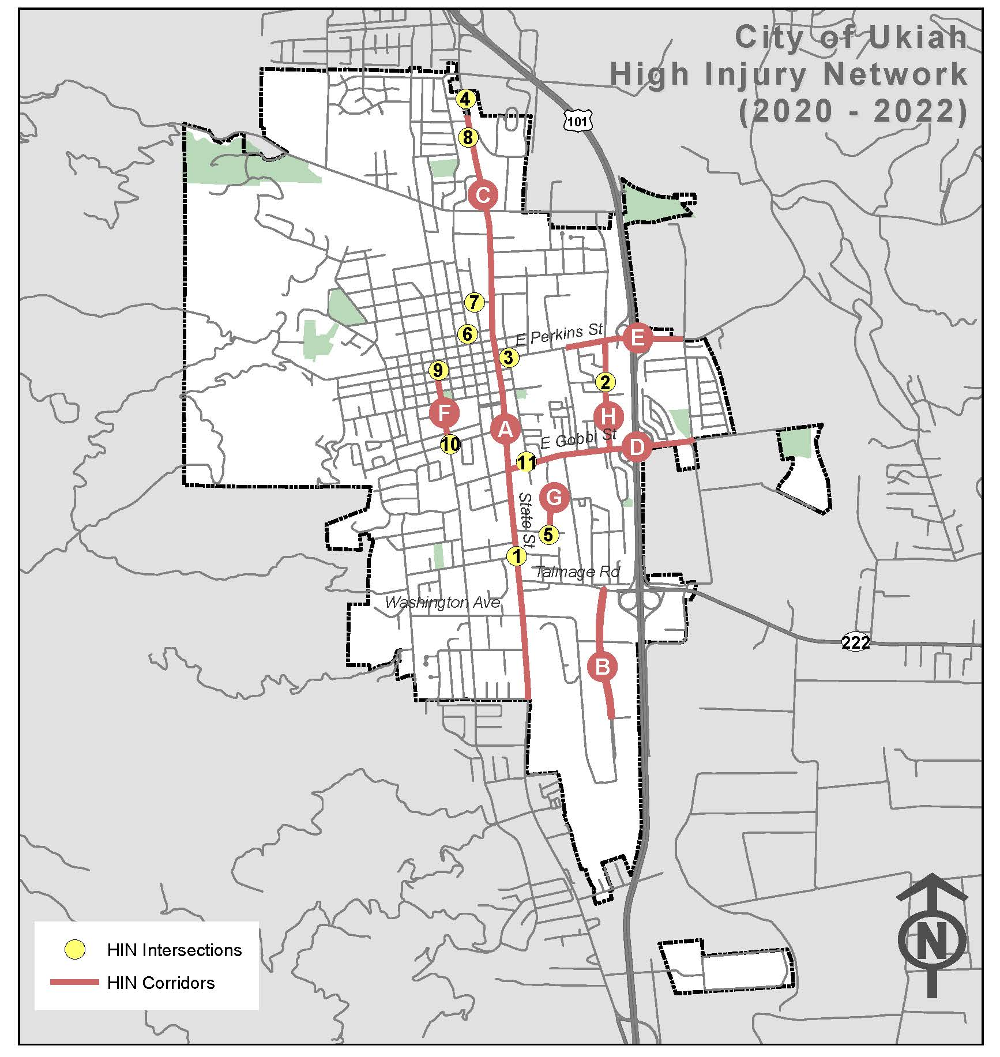
High Injury Network- Ukiah
City of Ukiah (2020-2022)
ID | Intersections | Total | Killed | Severe Injury | Pedestrian/ Bicycle | EPDO Score
1 | S State St & Observatory Ave | 6 | 0 | 2 | 2 | 359
2 | S Orchard Ave & Peach St | 2 | 0 | 1 | 1 | 176
3 | N Main St and E Perkins St | 2 | 0 | 1 | 1 | 171
4 | N State St & Bricarelli Dr | 2 | 0 | 1 | 0 | 171
5 | Apple Ave & Cherry St | 1 | 0 | 1 | 0 | 165
6 | N Oak St & W Smith St | 1 | 0 | 1 | 1 | 165
7 | Scott St & N School St | 1 | 0 | 1 | 1 | 165
8 | N State St & Mazzoni St | 1 | 0 | 1 | 1 | 165
9 | S Dora St & W Church St | 1 | 0 | 1 | 1 | 165
10 | S Dora St & W Mill St | 1 | 0 | 1 | 1 | 165
11 | E Gobbi St & S Main St | 1 | 0 | 1 | 0 | 165
ID | Corridors | Total Injury Collisions | Killed | Severe Injury | Pedestrian/Bicycle | Length (miles) | EPDO Score
A | S State St: Beacon Ln to W Perkins St | 8 | 0 | 1 | 1 | 2.5 | 217
B | Airport Park Blvd: Talmage Rd to Entrance to Costco Warehouse | 7 | 0 | 1 | 2 | 0.6 | 216
C | N State St: W Perkins St to Ukiah City Limit | 7 | 0 | 1 | 2 | 1.1 | 211
D | E Gobbi St: S State St to Washo Dr | 4 | 0 | 1 | 0 | 1.0 | 183
E | E Perkins St: S State St to Oak Manor Dr | 4 | 0 | 1 | 0 | 0.8 | 183
F | S Dora: W Church St to W Mill St | 2 | 0 | 1 | 1 | 0.3 | 171
G | Apple Ave: Entire length from Cherry St | 1 | 0 | 1 | 0 | 0.1 | 165
H | S Orchard Ave: E Perkins to E Gobbi St | 1 | 0 | 1 | 1 | 0.3 | 165
Note: Green indicates locations identified as part of High Injury Network (2015-2019)

Slide 30
Safety Projects-Ukiah
Non- Signalized Intersections
Location | Countermeasures
Project 1: Improve Safety at Non-Signalized Intersections.
S State St & Observatory Ave |  | NS08
S Orchard Ave & Peach St |  | NS08
N Main St and E Perkins St | NS01NT | NS08 | NS09
N State St & Bricarelli Dr |  | NS08
Apple Ave & Cherry St |  | NS08
N Oak St & W Smith St | NS01NT | NS08
Scott St & N School St |  | NS08
S Dora St & W Church St |  | NS08 | NS09
S Dora St & W Mill St | NS01NT | NS08
E Gobbi St & S Main St |  | NS08
NS01NT – Add intersection lighting (NS.I.)
NS08 – Install/upgrade larger or additional stop signs or other intersection warning/regulatory signs
NS09 – Upgrade intersection pavement markings (NS.I.)
Location | Countermeasures
Project 2: Improve Pedestrian and Bicycle Safety at Non-Signalized Intersections.
N. Orchard Ave & Clara Ave | NS23PB | NS24PB
S Orchard Ave & Peach St | NS23PB | NS24PB
N Main St and E Perkins St | NS23PB
N Oak St & W Smith St | NS23PB
Scott St & N School St | NS23PB
S Dora St & W Church St |  | NS24PB
S Dora St & W Mill St | NS23PB
NS23PB – Install/upgrade pedestrian crossing at uncontrolled locations (with enhanced safety features)
NS24PB – Install Rectangular Rapid Flashing Beacon (RRFB)

Slide 31
Safety Projects-Ukiah
Roadways
Location | Countermeasures
Project 3: Improve Safety at Roadway Segments.
S State St: Beacon Ln to W Perkins St | R22 | R26
Airport Park Blvd: Talmage Rd to Entrance to Costco Warehouse |  | R26
N State St: W Perkins St to Ukiah City Limits | R22 | R26
E Gobbi St: S State St to Washo Dr | R22 |  | Re-pavement
E Perkins St: S State St to Oak Manor Dr |  | R26
S Dora: W Church St to W Mill St | R22 | R26
S Orchard Ave: E Perkins to E Gobbi St | R22
R22 – Install/Upgrade signs with new fluorescent sheeting (regulatory or warning)
R26 – Install dynamic/variable speed warning signs
Location | Countermeasures
Project 4: Improve Safety at Roadway Segments.
S State St: Beacon Ln to W Perkins St |  | R36PB
Airport Park Blvd: Talmage Rd to Entrance to Costco Warehouse | R35PB | R36PB
S Dora: W Church St to W Mill St |  |  | R38PB
R35PB – Install sidewalk/pathway (to avoid walking along roadway)
R36PB – Install/upgrade pedestrian crossing (with enhanced safety features)
R38PB – Install Rectangular Rapid Flashing Beacon (RRFB)

Slide 32
Collision Analysis Findings- Willits
City of Willits (2020-2022)
Collisions by Severity (2020-2022)
Collision Severity | 2015-2019 |  |  | 2020-2022 |  |  | 2015-2022
 | City | State Routes | Total | City | State Routes | Total | Total
Killed | 0 | 0 | 0 | 0 | 1 | 1 | 1
Severe Injury | 1 | 4 | 5 | 4 | 1 | 5 | 10
Visible Injury | 5 | 4 | 9 | 3 | 3 | 6 | 15
Complaint of Pain | 4 | 20 | 24 | 4 | 2 | 6 | 30
Property Damage Only (PDO) | 37 | 120 | 157 | 5 | 9 | 14 | 171
Total | 47 | 148 | 195 | 16 | 16 | 32 | 227
Note: State Route 20 & Highway 101 collisions are included in the analysis
6 Killed & Severe Injury (KSI) collisions
Severity (2020-2022)
Violation Type (2020-2022)
Notes:
Change PIE CHART: Nomenclature
Change to KSI

Slide 33
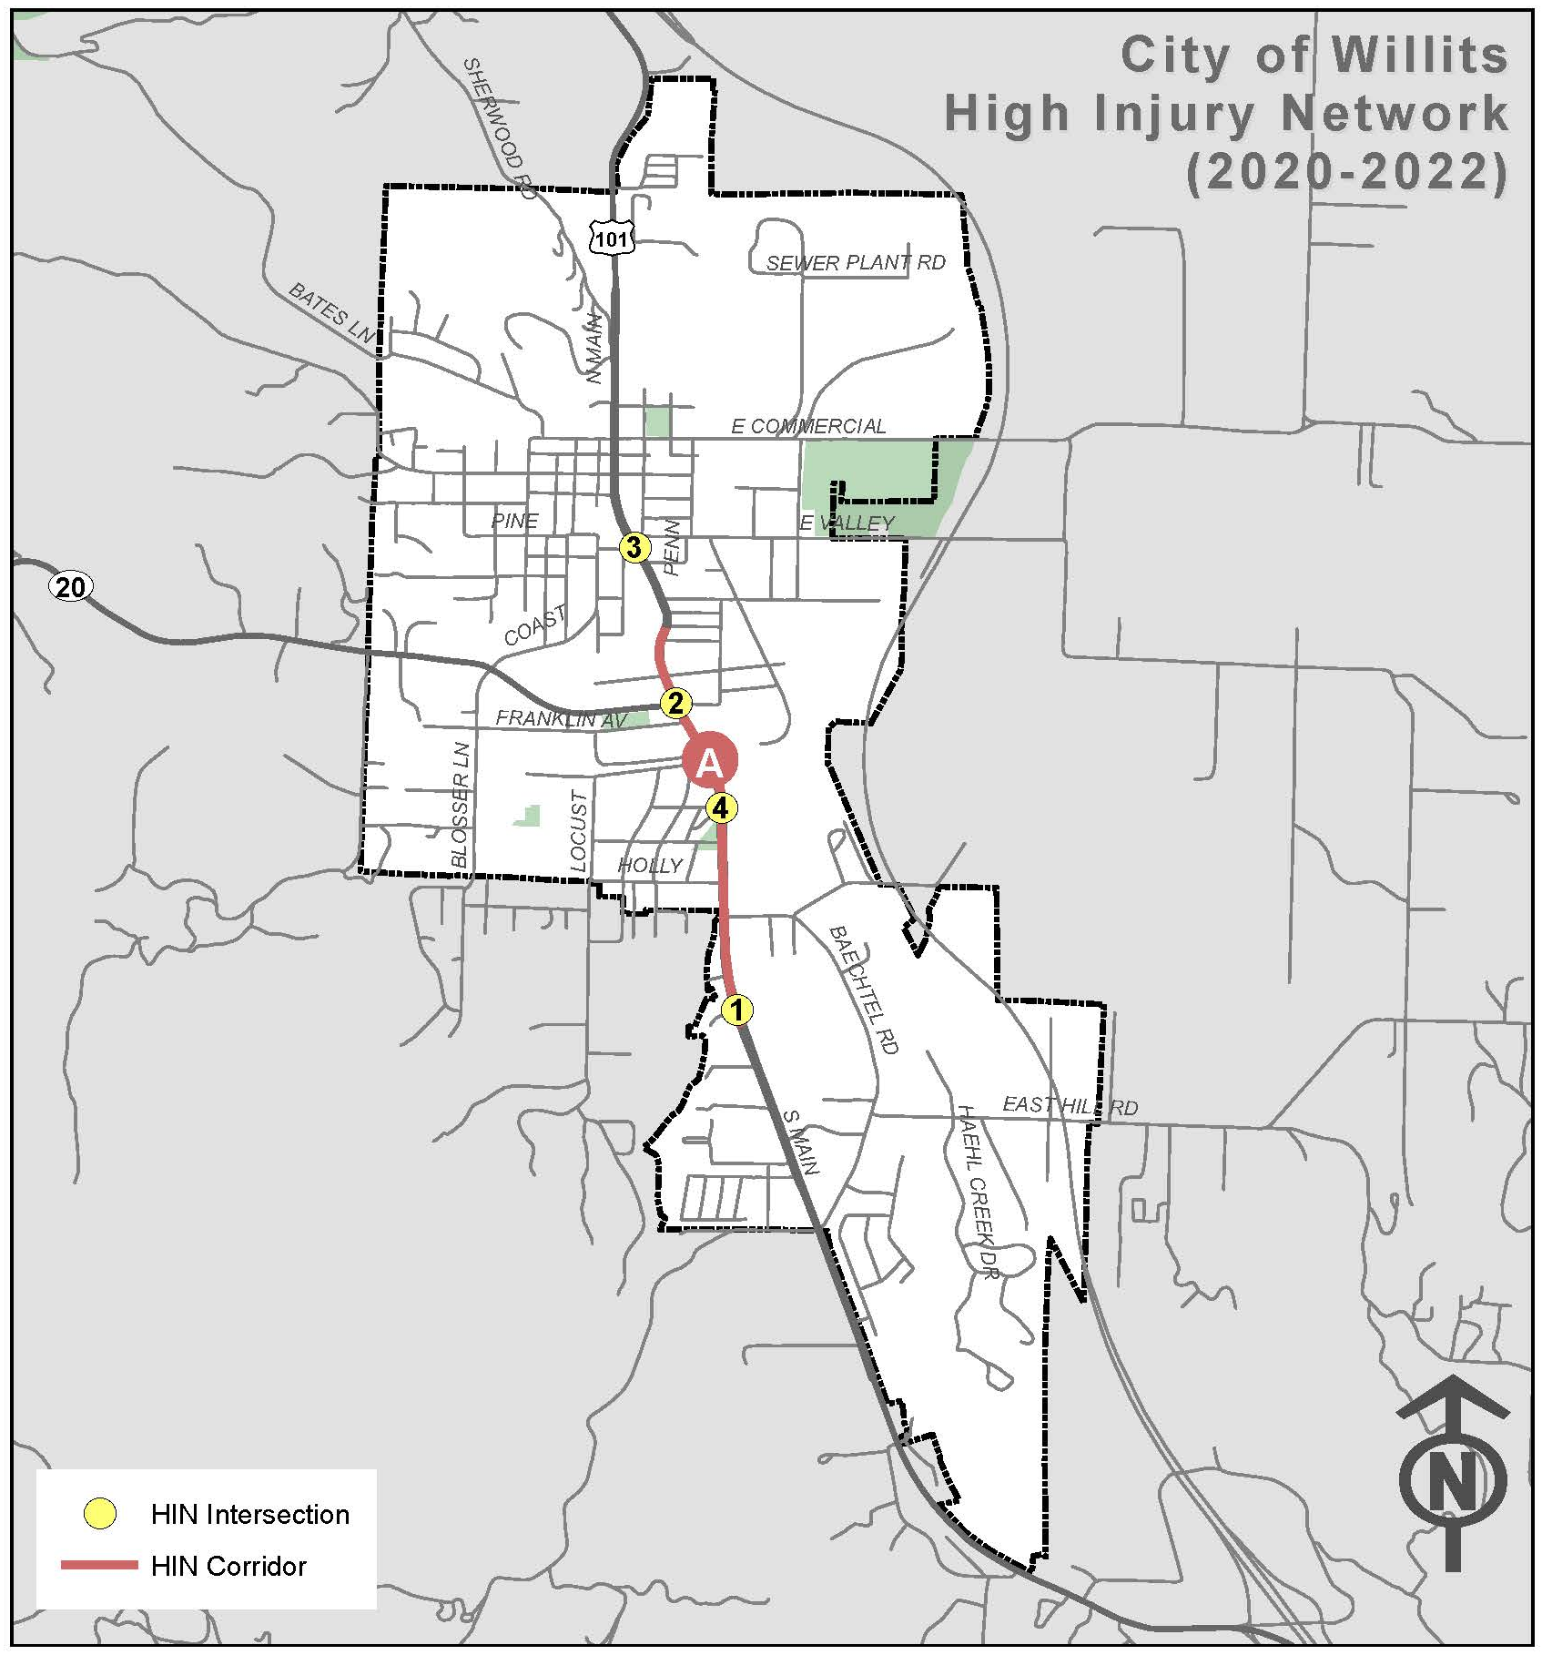
High Injury Network- Willits
City of Willits (2020-2022)
ID | Intersections | Total | Killed | Severe Injury | Pedestrian/Bicycle | EPDO Score
1 | S Main St & Gregory Ln | 5 | 1 | 2 | 1 | 512
2 | S Main St & Fort Bragg - Willits Rd/South St | 2 | 0 | 1 | 1 | 176
3 | S Main St & W Valley St | 1 | 0 | 1 | 0 | 165
4 | S Main St & Madrone St | 1 | 0 | 1 | 0 | 165
ID | Corridors | Total Injury Collisions | Killed | Severe Injury | Pedestrian/Bicycle | Length (miles) | EPDO Score
A | S Main Street: Monroe St to Gregory Ln | 2 | 0 | 1 | 2 | 0.9 | 176
Note: Green indicates locations identified as part of High Injury Network (2015-2019)

Slide 34
Safety Projects - Willits
Signalized Intersections
Location | Countermeasures
Project 1: Improve Safety at Signalized Intersections.
S Main St & Fort Bragg - Willits Rd/South St | SI03 | SI09
SI03 – Improve signal timing (co-ordination, phases, red, yellow, or operation)
SI09 – Install flashing beacons as advance warning (S.I.)
Location | Countermeasures
Project 2: Improve Pedestrian and Bicycle Safety at Signalized Intersections.
S Main St & Fort Bragg - Willits Rd/South St | SI18PB | SI21PB
SI18PB – Install pedestrian countdown signal heads
SI21PB – Install advance stop bar before crosswalk (Bicycle Box)
Non- Signalized Intersections
Location | Countermeasures
Project 3: Improve Safety at Non-Signalized Intersections.
S Main St & Gregory Ln | NS08 | NS09 | NS16
S Main St & W Valley St | NS08 |  | NS16
S Main St & Madrone St | NS08 | Re-pavement | NS16
NS08 – Install/upgrade larger or additional stop signs or other intersection warning/regulatory signs
NS09 – Upgrade intersection pavement markings (NS.I.)
NS16 – Install raised median on approaches (NS.I.)

Slide 35
Safety Projects - Willits
Roadways
Location | Countermeasures
Project 4: Improve Safety at Roadway Segments.
S Main Street: Monroe St to Gregory Ln | R08 | R22 | R26
R08 – Install raised median
R22 – Install/Upgrade signs with new fluorescent sheeting (regulatory or warning)
R26 – Install dynamic/variable speed warning signs

Slide 36
Non Engineering Strategies
Education
Conduct public information and education campaign for intersection safety laws, unsafe speeds, distracted driving, improper turning and driving under the influence.
Conduct bicycle and pedestrian safety campaigns and outreach to raise their awareness of bicycle and pedestrian safety needs through media outlets and social platforms
Implement tactical urbanism/public art projects
Enforcement
Targeted enforcement at high-injury locations.
Increase the number of personnel who have completed Advanced Roadside impaired Driving Enforcement (ARIDE) training
EMS
Install emergency vehicle pre-emption systems
Increase the number of EMS/fire control personnel taking Traffic Incident Management Training

Slide 37
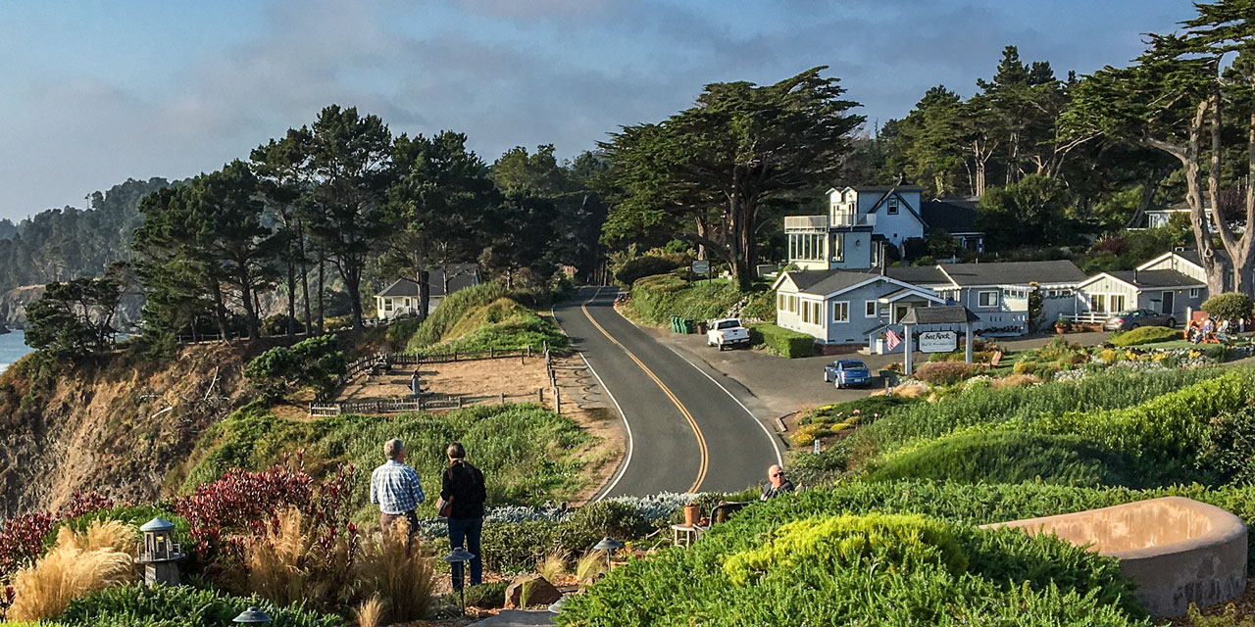
Next Steps
Finalize Safety Projects and calculate BCR/cost estimates
Finalize LRS/AP reports
Present to applicable Boards/Councils early-August

Slide 38
Discussion/Questions?

Slide 39
Thank you!

Slide 40
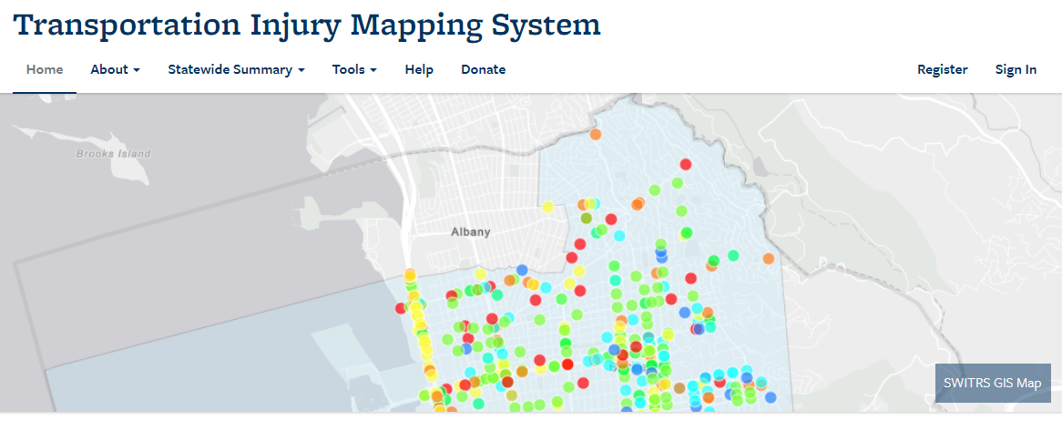
Data Collection
TJKM collected data from 2020-2022.
Data was collected from the Transportation Injury Mapping System (TIMS) and the Statewide Integrated Traffic Records System (SWITRS), just like for the previous LRSP collection analysis.
Any additional police reports, hospital reports, insurance claim information was not collected/reviewed as part of this analysis.

Slide 41
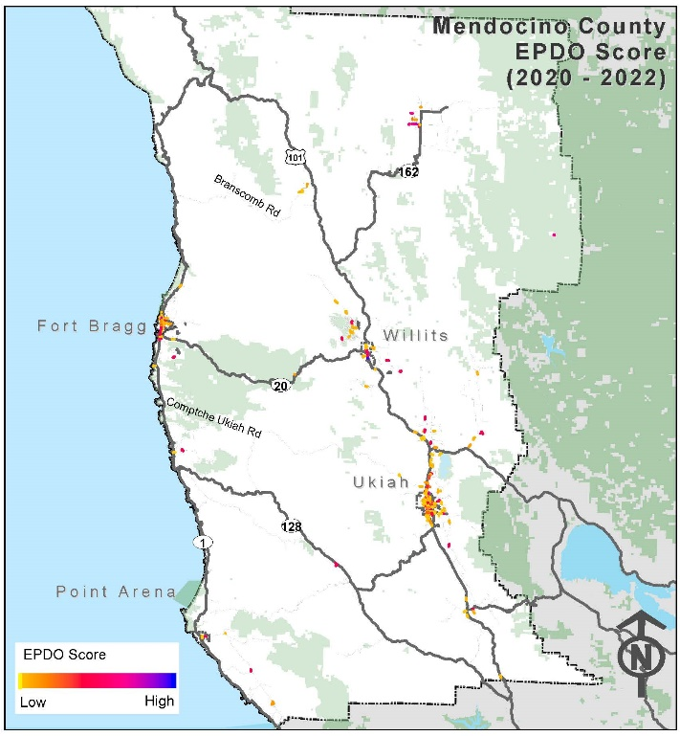
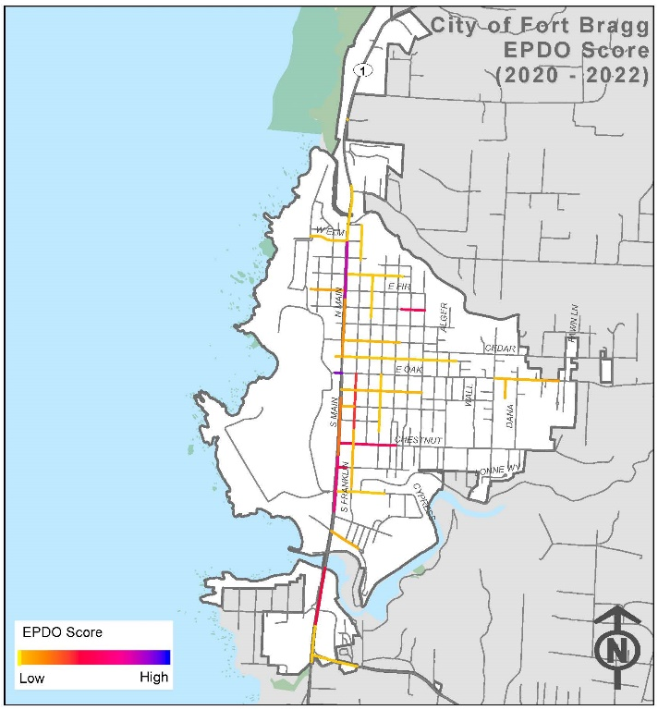
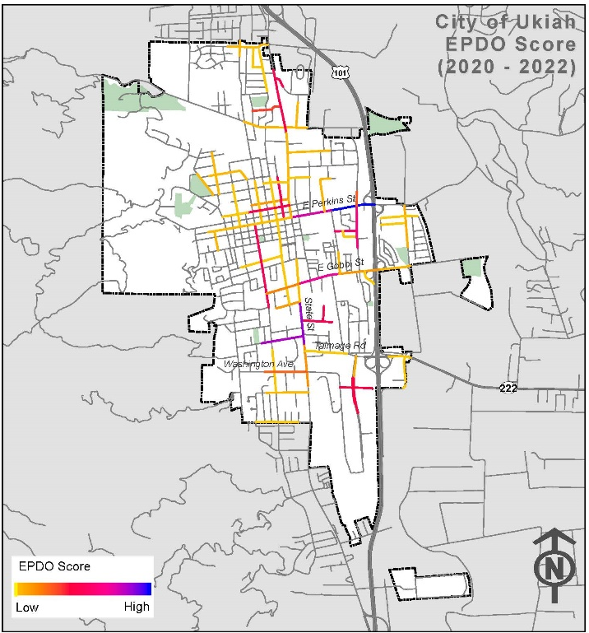
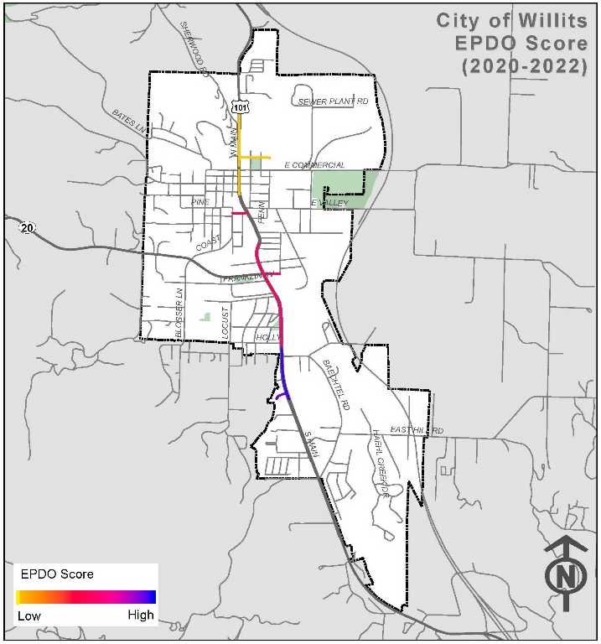
Equivalent Property Damage Only (EPDO) Score
Mendocino County - Unincorporated
City of Fort Bragg
City of Ukiah
City of Willits
EPDO Score =
(165 x # of Fatal Collisions) +
(165 x # of Severe Injury Collisions) +
(11 x # of Other Visible Injury Collisions) +
(6 x # of Complaint of Pain Collisions) +
(1 x # of PDO Collisions)
(Source: Local Roadway Safety Manual 2020, Caltrans)
Collision Severity | EPDO Score
Fatal | 165
Severe Injury | 165
Visible Injury | 11
Complaint of Pain | 6
Property Damage Only (PDO) | 1

